Slide 1
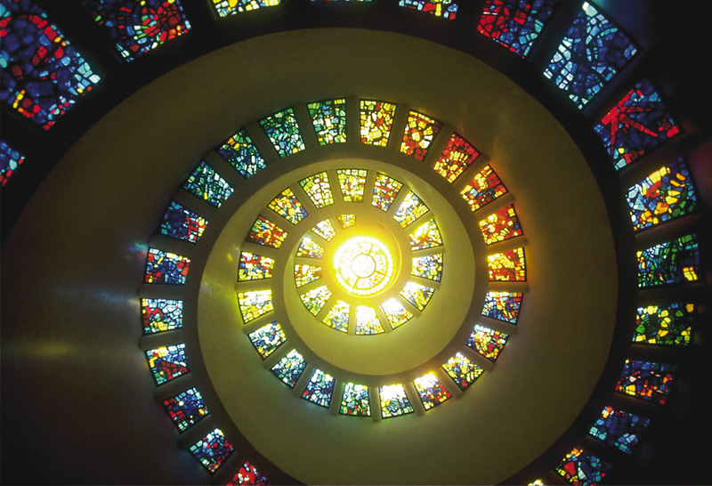
Chapter 23: Main-Group Elements II: Nonmetals
General Chemistry
Principles and Modern Applications
Petrucci • Harwood • Herring
8th Edition
Philip Dutton
University of Windsor, Canada
N9B 3P4
Prentice-Hall © 2002

Slide 2
Contents
23-1 Group 18: The Noble Gases
23-2 Group 17: The Halogens
23-3 Group 16: The Oxygen Family
23-4 Group 15: The Nitrogen Family
23-5 Group 14 Nonmetals: Carbon and Silicon
23-6 The Group 13 Nonmetal: Boron
Focus On Glassmaking

Slide 3
23-1 The Noble Gases
Initially thought to be chemically inert.
Pauling predicted reactivity of xenon.
  XeF₂, XeF₄, XeOF₂, XeF₆, XeO₃, XeO₄ and H₄XeO₆.
XeF₂(aq) + 2 H⁺(aq) + 2 e⁻ → Xe(g) + 2 HF(aq) E° = +2.64 V

Slide 4
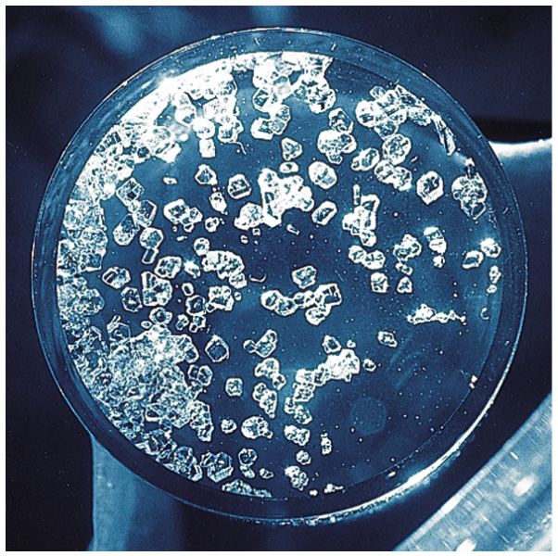
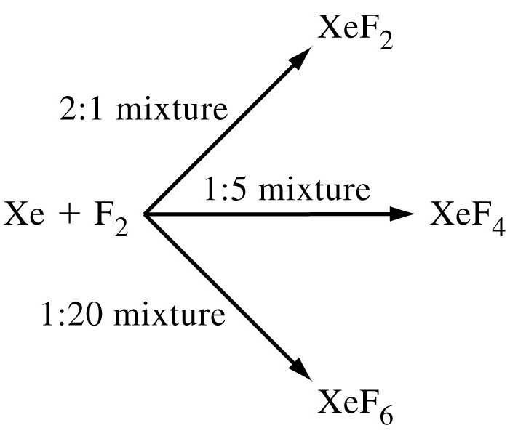
Xenon and Fluorine

Slide 5
23-2 Group 17: The Halogens
Diatomic molecules symbolized by X₂.
mp and bp increase down the period.
Reactivity decreases down the period.
Fluorine
  Most electronegative element.
  Forms strong bonds (ionic and covalent)

Slide 6
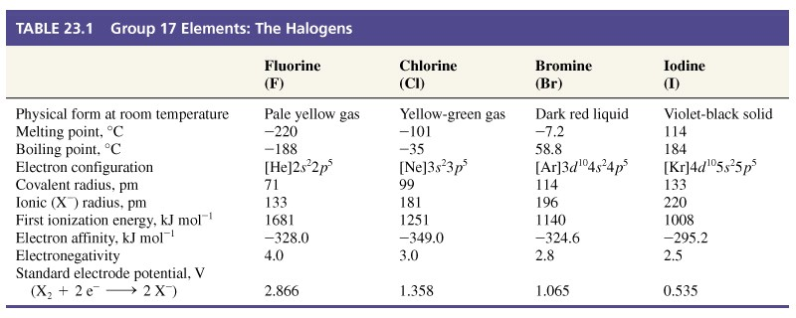
Table 23.1 Group 17 Elements: The Halogens

Slide 7
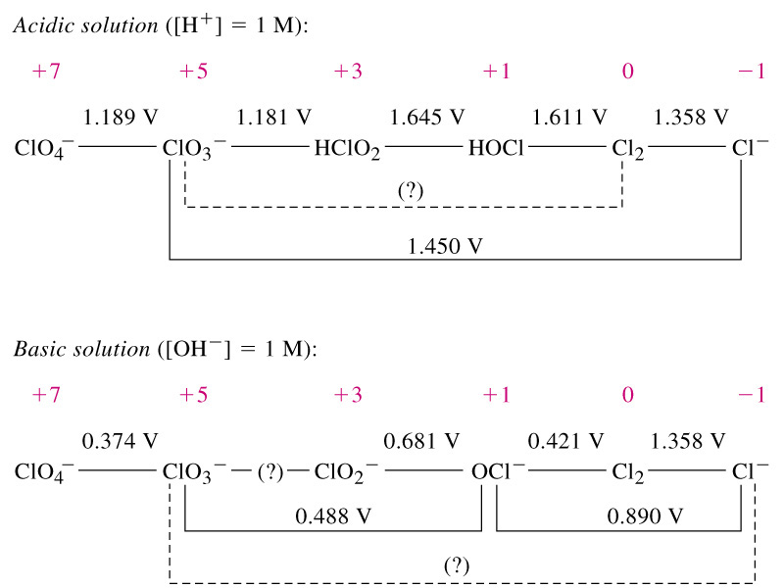
Electrode Potential Diagrams

Slide 8
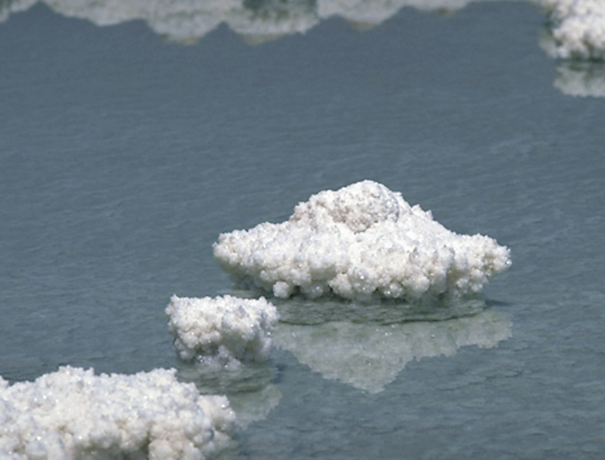
Production and Uses of Halogens
Notes:
Dead sea is a good source of bromine.

Slide 9
Production and Uses of Halogens
Chlorine and fluorine
  by electrolysis, for example:
Bromine
  Seawater is 70 ppm Br⁻, acidify and oxidize with Cl₂
2 HF → H₂(g) + F₂(g)
Cl₂(g) + 2 Br⁻(aq) → 2 Cl⁻ + Br₂(l) E°_{cell} = 0.293 V

Slide 10
Production and Uses of Halogens
Iodine
  Also obtained from inland brines and certain sea plants.
  NaIO₃ is found in large deposits in Chile.
    Usually reduced with bisulfite.
Many useful compounds can be formed from halogens.

Slide 11
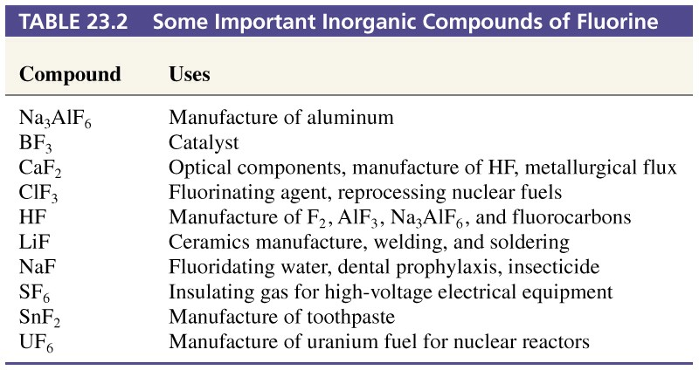
Table 23.2 Some Important Inorganic Compounds of Fluorine

Slide 12
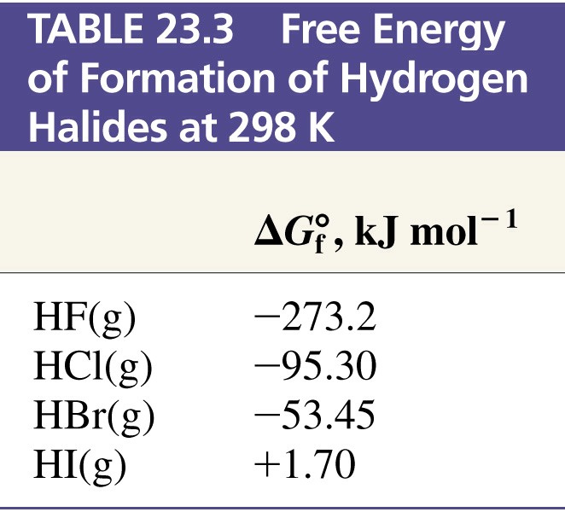
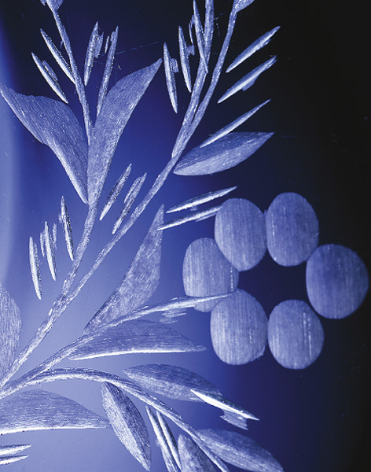
Hydrogen Halides
CaF₂(s) + H₂SO₄(aq) → CaSO₄(s) + 2 HF(g)
H₂(g) + X₂(g) → 2 HX(g)
SiO₂(s) + HF(aq) → 2 H₂O(l) + SiF₄(g)

Slide 13
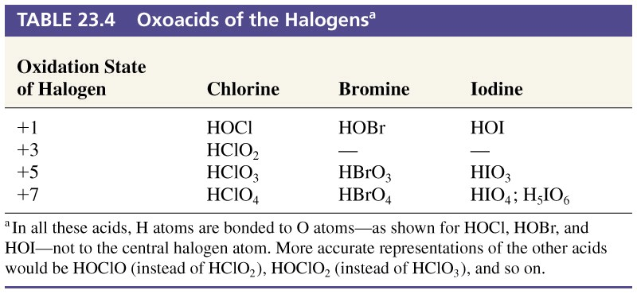
Table 23.4 Oxoacids of the Halogens

Slide 14
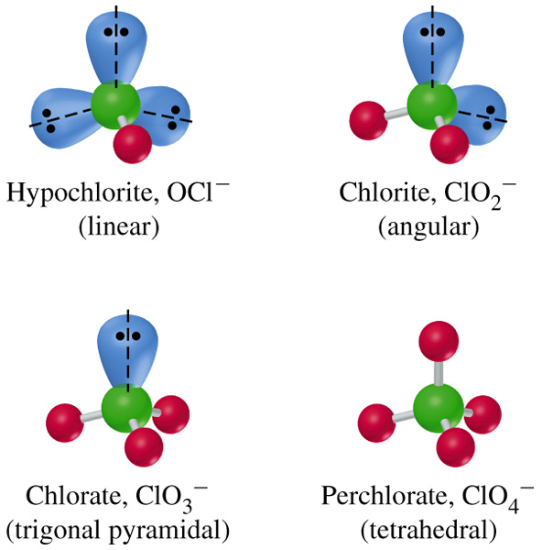
Oxoanions of Chlorine

Slide 15
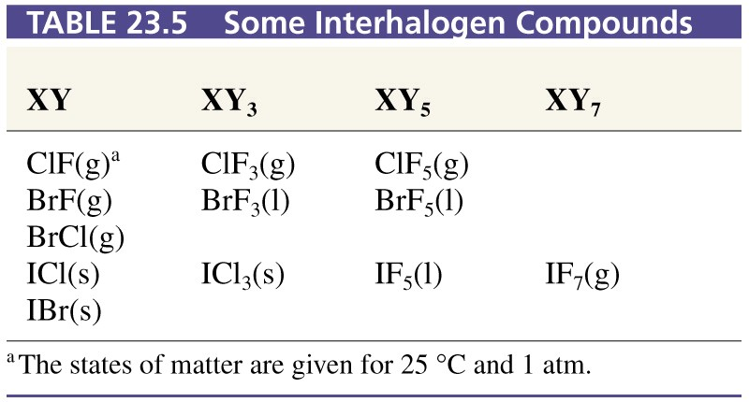
Table 23.5 Some Interhalogen Compounds

Slide 16
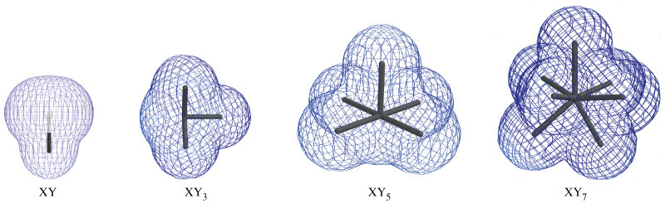
Structures of Interhalogen Compounds

Slide 17
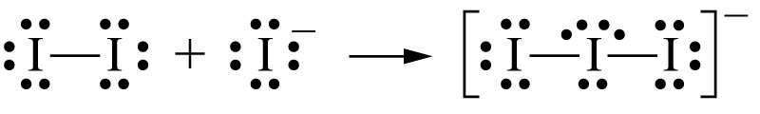
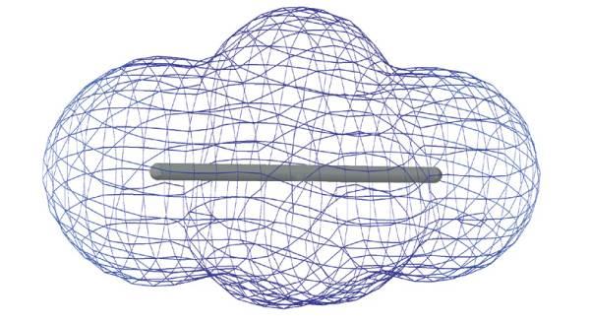
Polyhalide Ions

Slide 18
23-3 Group 16: The Oxygen Family
S and O are clearly nonmetallic in behavior
Similar compounds:
  H₂S and H₂O CS₂ and CO₂ SCl₂ and Cl₂O
Important differences
  Due to properties and characteristics of O.
    Small size, high electronegativity and inability to employ an expanded valence shell.
      Hydrogen bonding in water but not in H₂S.
      OS (O) -2, -1 and 0, but OS(S) -2 to +6 inclusive.

Slide 19
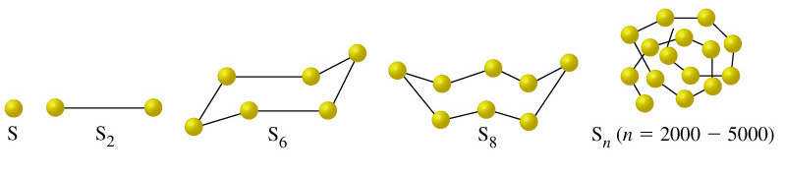
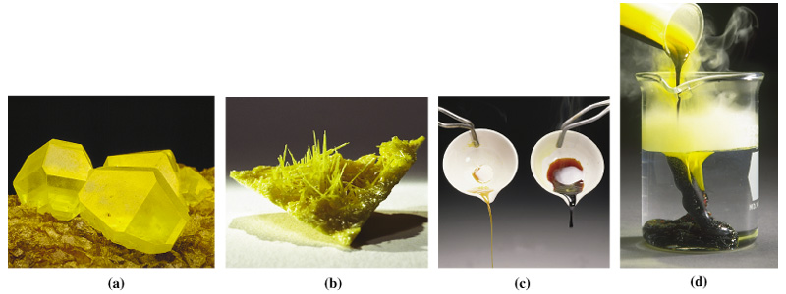
Allotropy and Polymorphism

Slide 20
Occurrence of S and O
Oxygen is most abundant element in earths crust (45.5%) and seawater (90%), in the atmosphere it is second only to N₂ (23.25% by mass).
Sulfur is 16th most abundant element in the crust (0.0384%).
  Main use is conversion to sulfuric acid.
  Also used in vulcanization and for dusting grapevines.

Slide 21
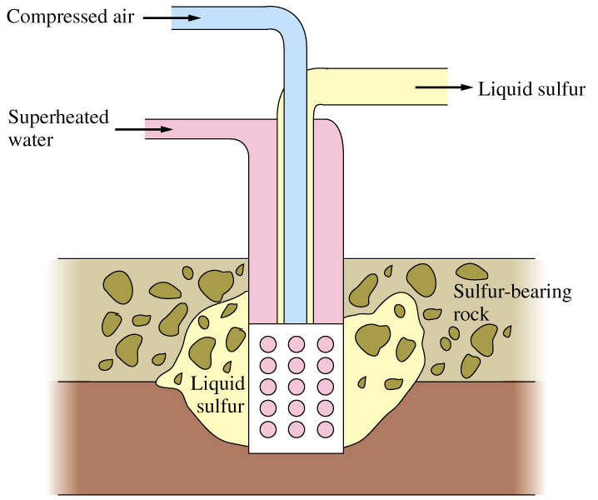
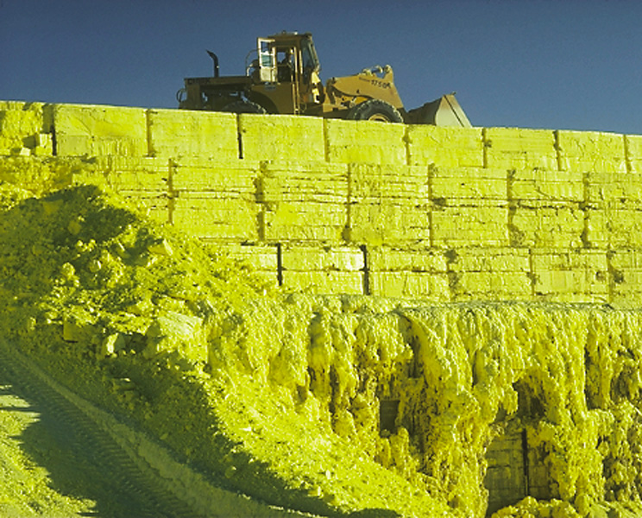
The Frasch Process
Sulfur is also obtained from oil and gas deposits and is recovered in the refining process.

Slide 22
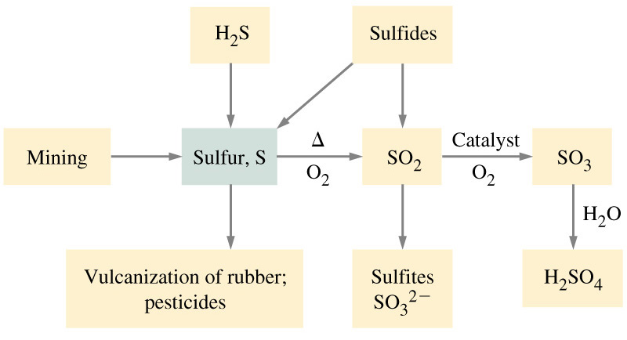
Sources and Uses of S and its Oxides

Slide 23
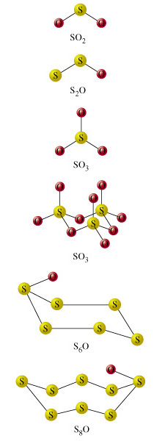
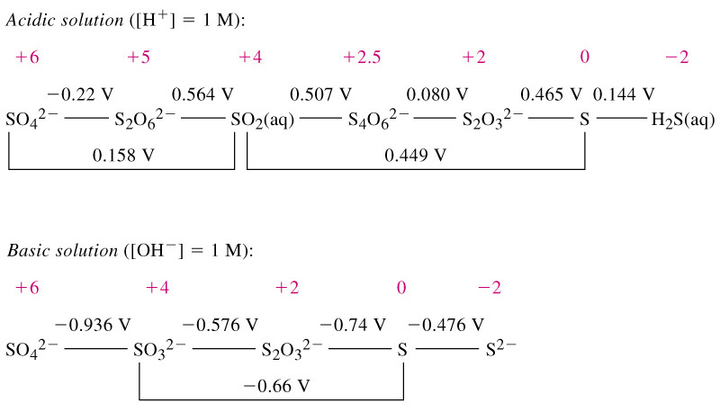
Oxides, Oxoacids and Oxoanions of S

Slide 24
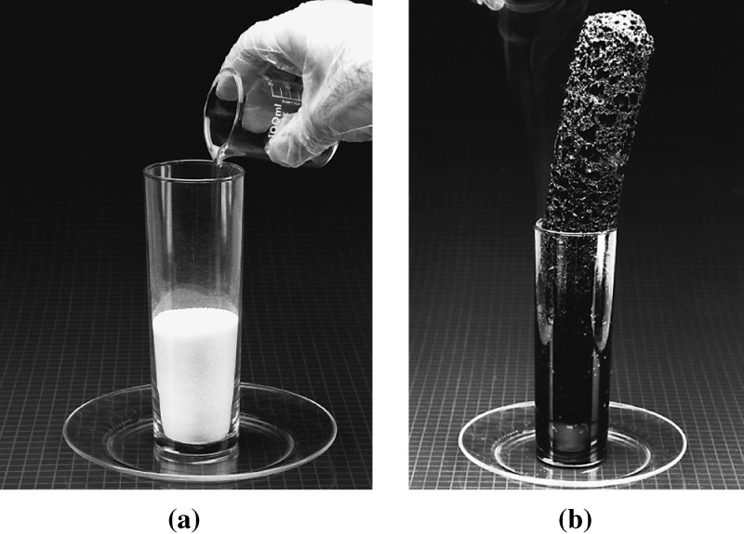
Sulfur Oxoacids
SO₃(g) + H₂SO₄(l) → H₂S₂O₇(l)
H₂S₂O₇(l) + H₂O(l) → 2 H₂SO₄(l)
Dilute H₂SO₄
  A diprotic acid.
Concentrated H₂SO₄
  High affinity for water.

Slide 25
Sulfates and Sulfites
Gypsum and Plaster of Paris.
Sulfites solubilize lignin.
Thiosulfate S₂O₃²⁻.
  The two sulfurs are not equivalent.
  Photographic processes.
  Analytical reagent (determination of I⁻)

Slide 26
Environmental Issues
Smog consists mainly of particulate (ash and smoke), SO₂ and H₂SO₄ mist.
  Main contributor is the emission of SO₂.
  Acid rain.
  Levels of SO₂ and H₂SO₄ above 0.10 ppm are considered potentially harmful.
    Especially to respiratory tract.

Slide 27
23-4 Group 15: The Nitrogen Family
Rich chemistry that can only be touched on here.
  Nitrogen can exist in many oxidation states.
N and P are nonmetallic.
As and Sb are metalloid.
Bi is metallic.

Slide 28
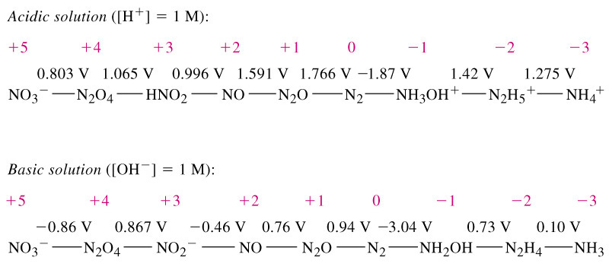
Oxidation States of N

Slide 29
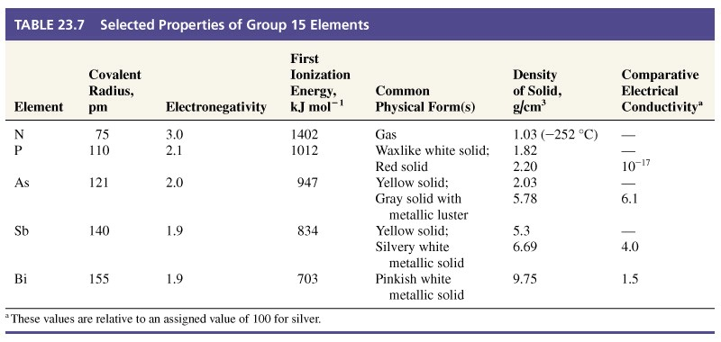
Table 23.7 Selected Properties of Group 15 Elements

Slide 30
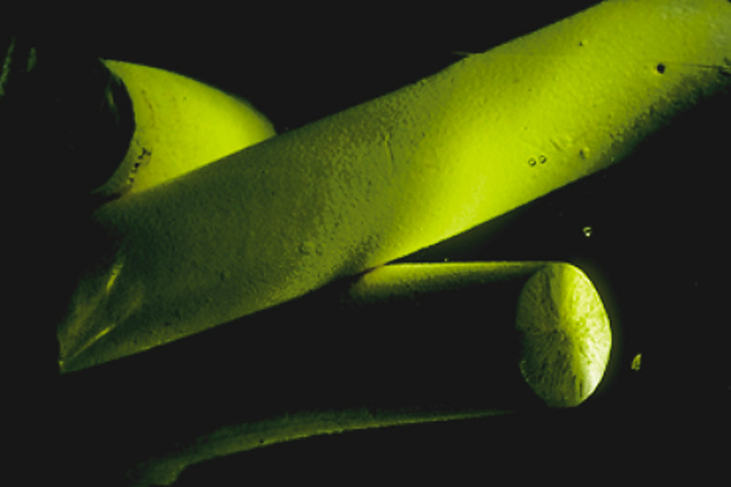
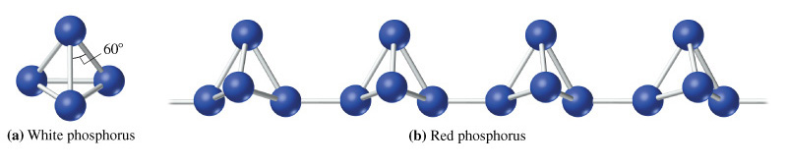
Allotropy of P

Slide 31
Production and Use
P is 11th most abundant element in the earths crust (0.11%).
  Originally purified from putrefied urine.
  Now obtained by heating apatites (phosphate rock of various compositions) in a furnace, for example:
2 Ca₃(PO₄)₂(s) + 10 C(s) + 6 SiO₂(s) →
6 CaSiO₃(s) + 10 CO(g) + P₄(s)

Slide 32
Production and Use
As obtained by heating metal sulfides.
  FeAsS gives FeS and As(g).
Sb is also obtained from sulfide ores.
As and Sb used to manufacture alloys.
  Added to lead for electrodes in storage batteries.
  Semiconductor doping.
Bi is a biproduct of other metal refining.

Slide 33
Nitrides
3 Mg(s) + N₂(g) → Mg₃N₂(s) A very strong base.
Mg₃N₂(s) + H₂O(l) → 3 Mg(OH)₂(s)+ NH₃(g)
With other non-metals nitrides form covalent bonds.
(CN)₂ P₃N₅ As₄N₄ S₂N₂ S₄N₄

Slide 34
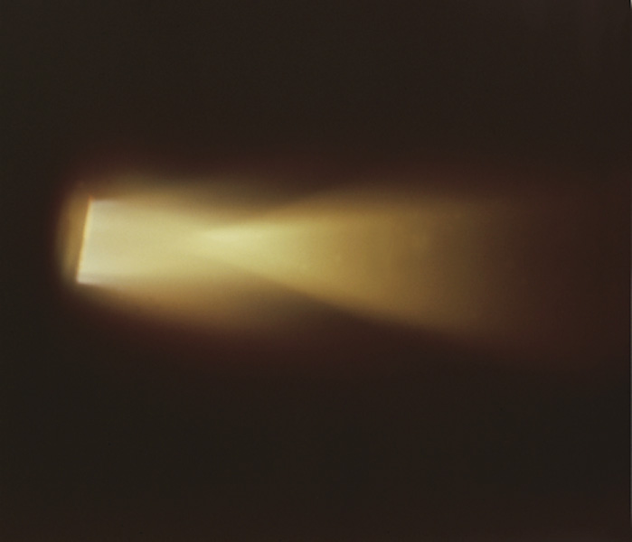
Hydrides of Nitrogen
N₂H₄(l) + O₂(g) → N₂(g) + 2 H₂O(l) ΔH° = -622.2 kJ/mol

Slide 35
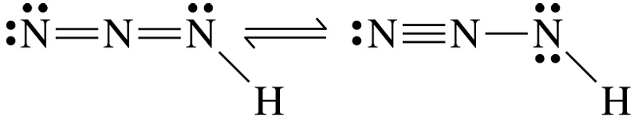
Hydrazoic Acid and Azides
A weak acid.
Salts (azides) decompose explosively.
  Pb salts used in detonators.
  Na salts used in air-bag systems.
  Salts are also useful in organic synthesis for the introduction of nitrogen functionality.

Slide 36
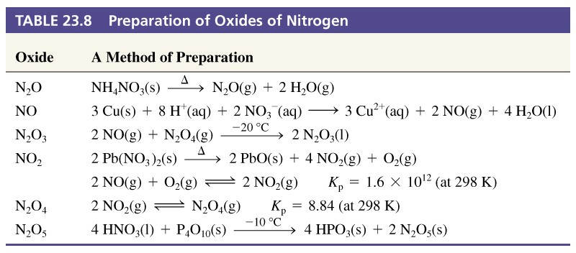
Oxides of Nitrogen

Slide 37
Phosphorus Compounds
P₄(s) + 3 OH⁻(aq) + 3 H₂O(l) → 3 H₂PO₂⁻(aq) + PH₃(g)
PCl₃(l) + 6 H₂O(l) → 3 H₃PO₃(aq) + 3 H₃O⁺(l) + 3 Cl⁻(aq)

Slide 38
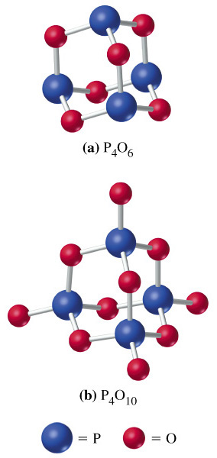
Oxides and Oxoacids of P
+ 6 H₂O(l) → 4 H₃PO₃(l)
phosporus acid
+ 6 H₂O(l) → 4 H₃PO₄(l)
phosporic acid

Slide 39
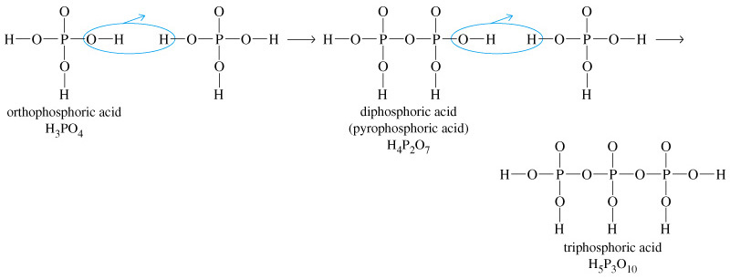
Polyphosphoric Acids

Slide 40
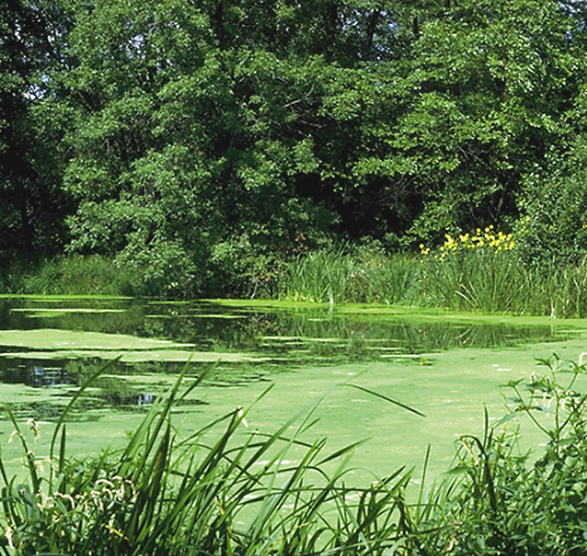
Eutrophication

Slide 41
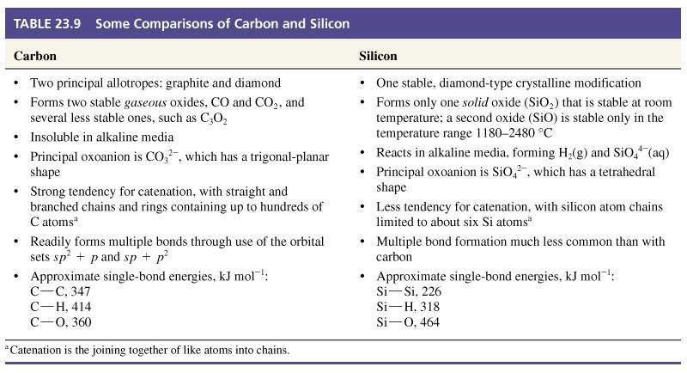
23-5 Group 14 Nonmetals:
Carbon and Silicon

Slide 42
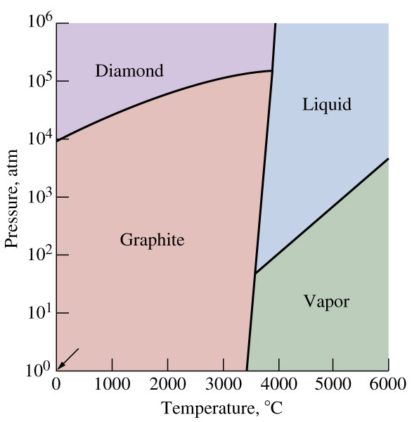
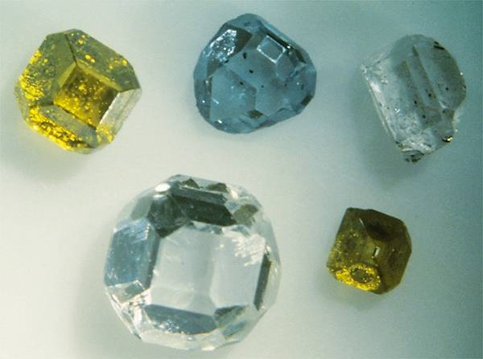
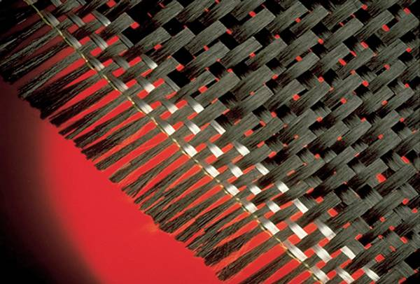
Carbon

Slide 43
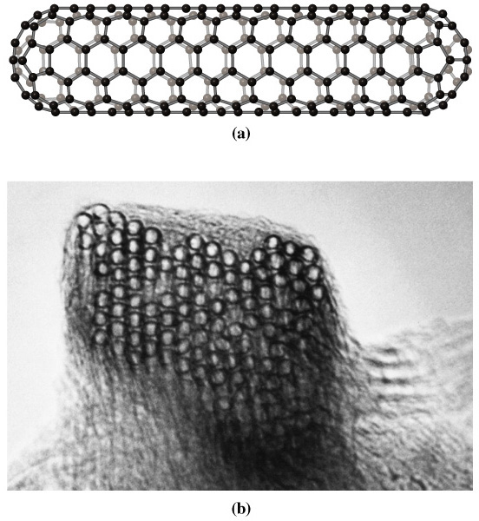
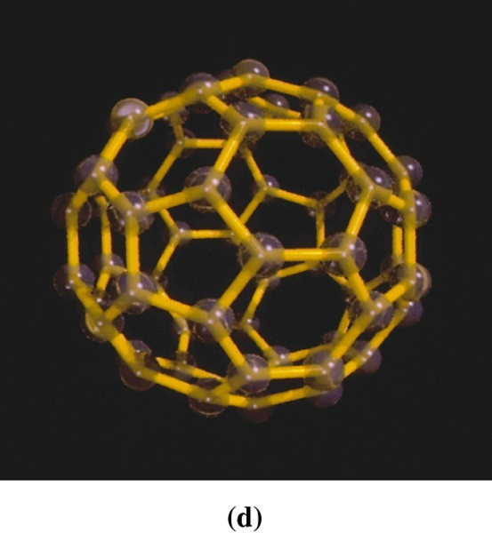
Carbon

Slide 44
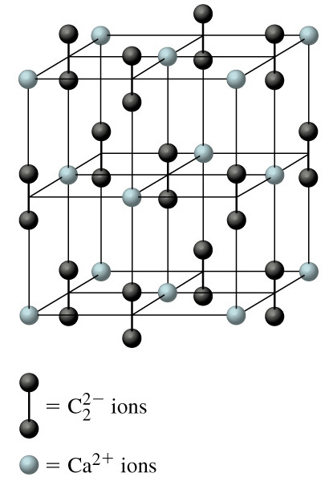
Inorganic Compounds of Carbon
CaC₂
  Reaction with H₂O produces acetylene.
  miner’s lamps.
CS₂
  Flammable, volatile, poisonous.
  Important solvent.
CCl₄
  Known carcinogen.

Slide 45
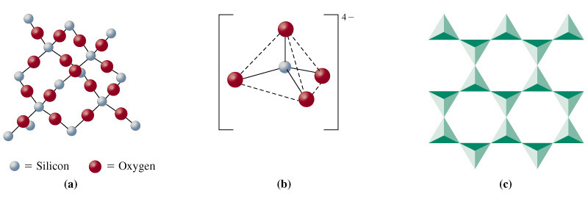
Production and Use of Si
Reduce quartz or sand with C in a furnace.
Oxides of Si, only one is stable, SiO₂.
silica
silicate
mica

Slide 46
Ceramics and Glasses
Hydrated silicate polymers are important in the ceramic industry.
  Sol-gel process produces exceptionally lightweight ceramic materials.
  Electrical, magnetic and optical applications.
  Mechanical and structural properties are also important.

Slide 47
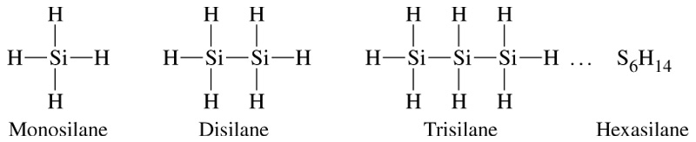
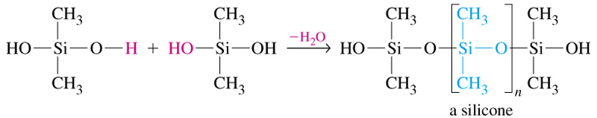
Silanes and Silicones

Slide 48
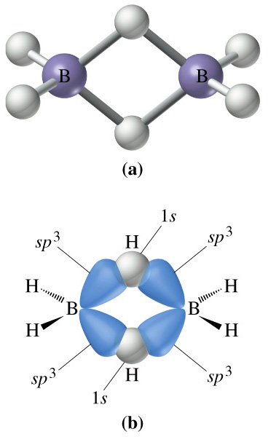
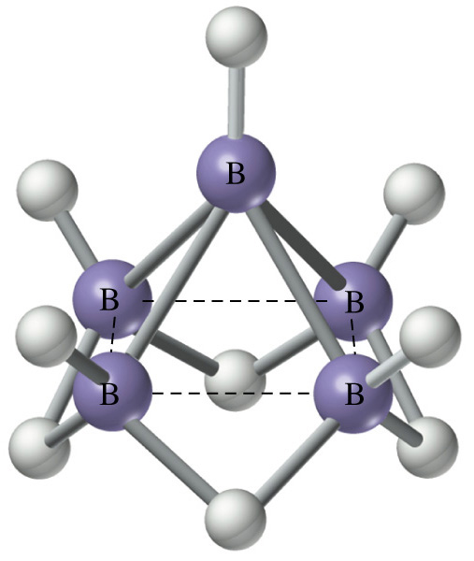
23-6 The Group 13 Nonmetal: Boron

Slide 49
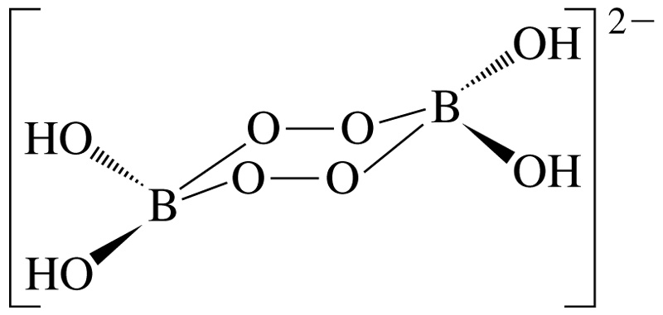
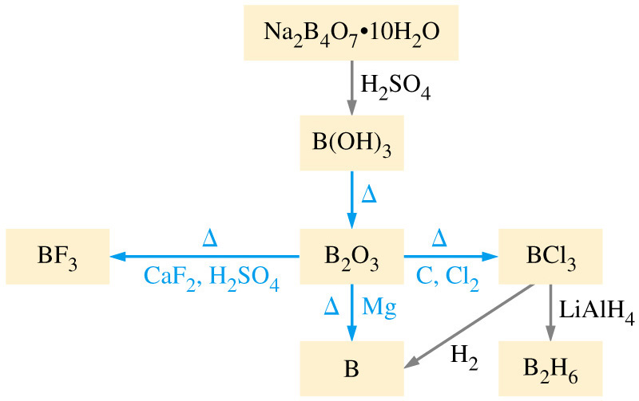
Other Boron Compounds

Slide 50
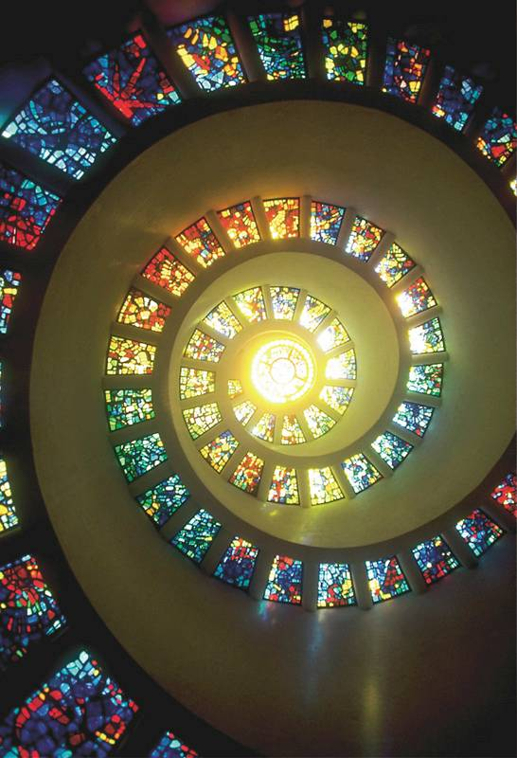
Focus On Glassmaking
Soda-lime glass.
  The oldest form of glass.
  Na₂CO₃ + CaCO₃ + SiO₂
  Fused at 1300C.
Small amounts of impurities impart beautiful colors.
  Fe₂O₃ green
  CoO blue
Adding B₂O₃ gives strength.
  Borosilicate glass – Pyrex®

Slide 51
Chapter 23 Questions
Develop problem solving skills and base your strategy not on solutions to specific problems but on understanding.
Choose a variety of problems from the text as examples.
Practice good techniques and get coaching from people who have been here before.

